Slide 1
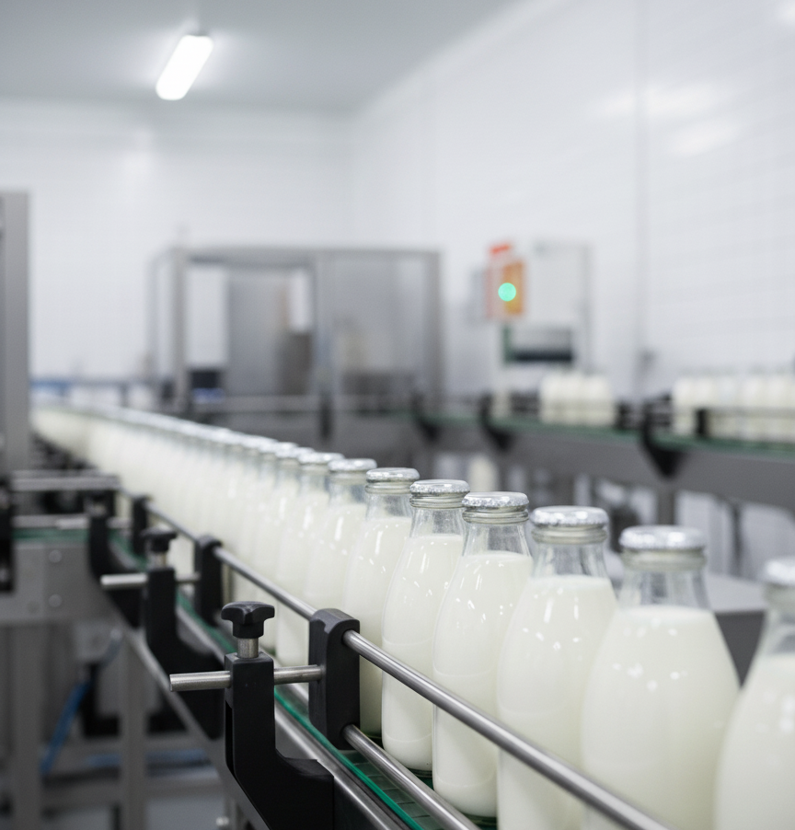

Title: NLP for Quality Control Reports in Production Objective: To design an AI-based defect detection system for bottle production lines using image classification and natural language processing for defect analysis. Course: MDM-09 Case Study: Intelligent Systems in Production Presented by: Teja Tadisetty Boshi Zhao Anandu Hari Guided by: Dr.Hamidreza Heidari Date: October 16, 2025

Slide 2
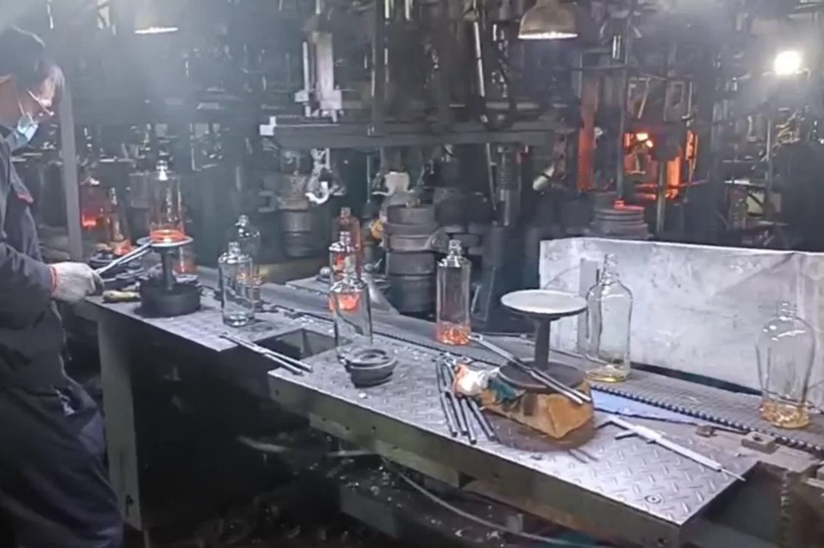
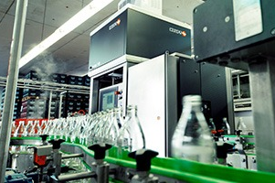
Manual inspection vs. AI-based vision system. Motivation & Scope
Motivation:
● Manual inspection in dairy factories is time-consuming and error-prone.
● AI-based vision systems can reduce inspection time and improve quality accuracy.
Scope:
● Analyze milk bottle defects (scratches, leakage, color fading) via image recognition.
● Apply NLP to analyze operator defect reports for trend identification.

Slide 3
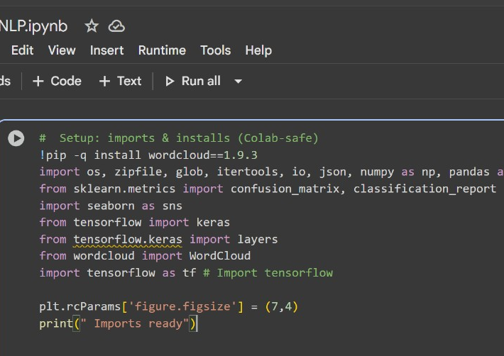
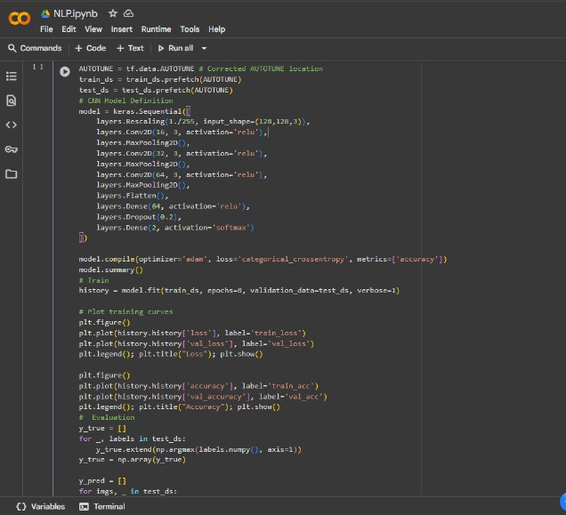
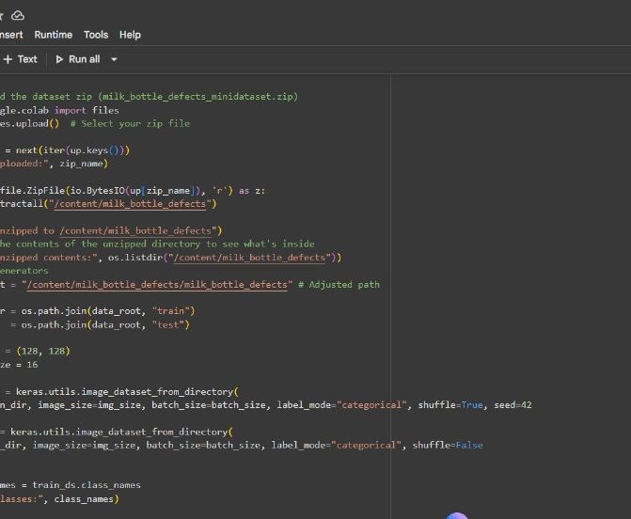
Software simulation
Tools used for model training and visualization. Research & Tools
Research Focus:
● Computer Vision for defect detection in production.
● NLP for quality feedback automation.
Tools & Software:
Purpose | Tool
Model Training | Python
Data Processing | Pandas,NumPy
NLP Analysis | NLTK,spaCy
Visualization | Matplotlib,WordCloud
Simulation | Google Colab

Slide 4
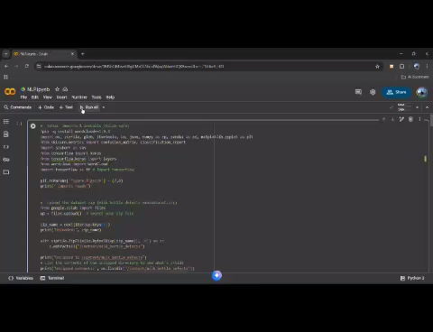
Prototype model output and classification results.
Prototype Build (MVP)
Workflow:
1. Load and preprocess milk bottle defect dataset.
2. Train CNN (MobileNetV2) for image classification.
3. Generate classification accuracy & confusion matrix.
4. NLP module analyzes defect descriptions (optional).
Output:
● Defective vs. good bottle classification.
● Defect frequency analysis (WordCloud).

Slide 5
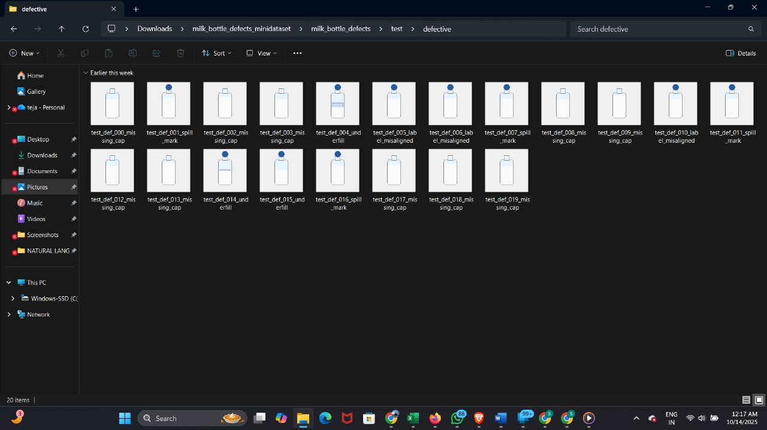
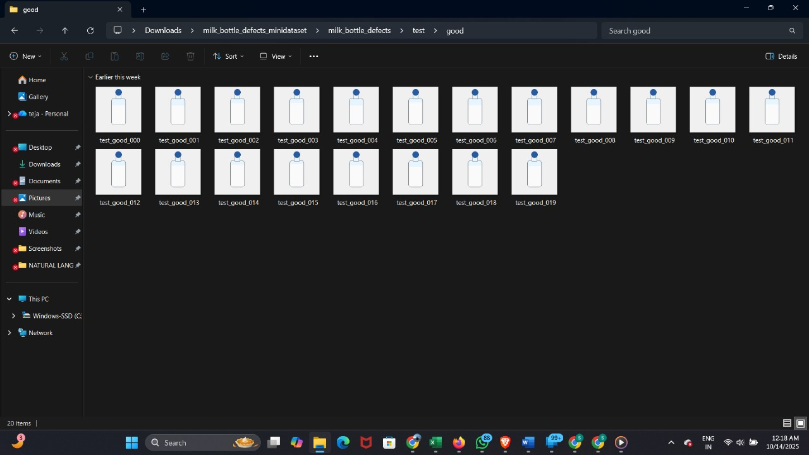
Example dataset samples used for model training.
Bill of Materials (BOM)
Component | Description
Dataset(good & defective) | Milk bottle images
Libraries | NLTK, TensorFlow
Environment | Google Colab
NLP(Defect type samples) | Data labels.csv

Slide 6
Project Milestones
OCTOBER 16 | Proposal
NOVEMBER 06 | Literature Map & Method Outline;Baseline Code/Sim
NOVEMBER 27 | Methodology
DECEMBER 18 | Demo; Experiments and Analysis
JANUARY 15 | Final Presentation and Report

Slide 7

Tech Stack & Safety
Tech Stack:
● Python 3.12, TensorFlow, OpenCV, Power BI
● NLP: NLTK, spaCy
● Platform: Google Colab + GitHub
Safety Checklist:
● Uses open-source datasets only
● Simulation-based (no live machinery)
● Follows ethical AI & data privacy guidelines

Slide 8
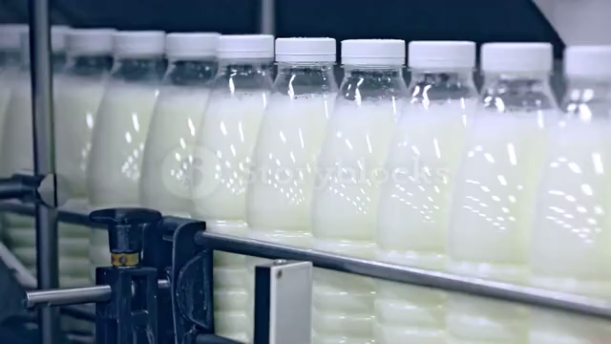
Expected Outcomes
Deliverables:
● Working CNN model for visual defect detection.
● NLP analysis of textual defect logs.
● Improved inspection efficiency & decision support.
Future Work:
● Integrate with real-time video inspection.
● Expand to multi-product quality analysis.

Slide 9
References
1. Bergmann, P., et al. (2020). MVTec AD – A Comprehensive Real-World Dataset for
Unsupervised Anomaly Detection. International Journal of Computer Vision.
2. Pysource (2025). Autonomous Defect Recognition from Scratch with Python.
3. Storyblocks Factory Video Dataset (2025).
4. Nayak, A., & Dutta, D. (2023). A comprehensive review on CRISPR and artificialintelligence based emerging food packaging technology to ensure “safe food”.Sustainable Food Technology, 1(5), 641–657.

Slide 10
Thank You

